Slide 1
Data Mining
Association Rule Mining

Slide 2
What Is Frequent Pattern Analysis?
Frequent pattern: a pattern (a set of items, subsequences, substructures, etc.) that occurs frequently in a data set
First proposed by Agrawal, Imielinski, and Swami [AIS93] in the context of frequent itemsets and association rule mining
Motivation: Finding inherent regularities in data
  What products were often purchased together?
  What are the subsequent purchases after buying a PC?
  What kinds of DNA are sensitive to this new drug?
  Can we automatically classify web documents?
Applications
  Basket data analysis, cross-marketing, catalog design, sale campaign analysis, Web log (click stream) analysis, and DNA sequence analysis.
Data Mining: Concepts and Techniques

Slide 3
Why Is Freq. Pattern Mining Important?
Discloses an intrinsic and important property of data sets
Forms the foundation for many essential data mining tasks
  Association, correlation, and causality analysis
  Sequential, structural (e.g., sub-graph) patterns
  Pattern analysis in spatiotemporal, multimedia, time-series, and stream data
  Classification: associative classification
  Cluster analysis: frequent pattern-based clustering
Data Mining: Concepts and Techniques

Slide 4

Association Rule Mining
Given a set of transactions, find rules that will predict the occurrence of an item based on the occurrences of other items in the transaction
Market-Basket transactions
Example of Association Rules
{Diaper} → {Beer},
{Milk, Bread} → {Eggs,Coke},
{Beer, Bread} → {Milk},
Implication means co-occurrence, not causality!

Slide 5

Definition: Frequent Itemset
Itemset
  A collection of one or more items
    Example: {Milk, Bread, Diaper}
  k-itemset
    An itemset that contains k items
Support count (σ)
  Frequency of occurrence of an itemset
  E.g. σ({Milk, Bread,Diaper}) = 2
Support
  Fraction of transactions that contain an itemset
  E.g. s({Milk, Bread, Diaper}) = 2/5
Frequent Itemset
  An itemset whose support is greater than or equal to a minsup threshold
itemsets are ordered lexicographically

Slide 6
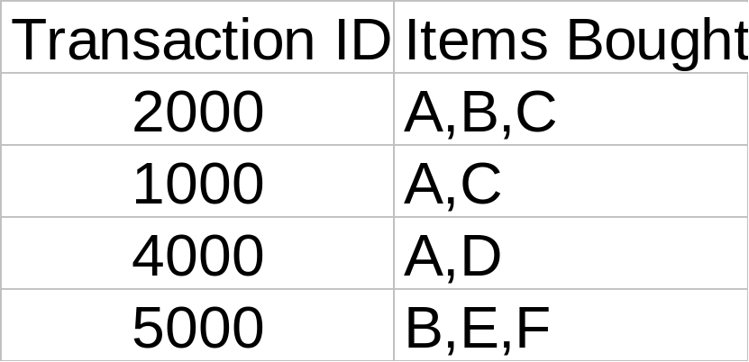
Definition: Association Rule
Let D be database of transactions
  e.g.:
Let I be the set of items that appear in the database, e.g., I={A,B,C,D,E,F}
A rule is defined by X ⇒ Y, where X⊂I, Y⊂I, and X∩Y=∅
  e.g.: {B,C} ⇒ {E} is a rule

Slide 7



Definition: Association Rule
Association Rule
  An implication expression of the form X → Y, where X and Y are itemsets
  Example:
  {Milk, Diaper} → {Beer}
Rule Evaluation Metrics
  Support (s)
    Fraction of transactions that contain both X and Y
  Confidence (c)
    Measures how often items in Y
    appear in transactions that
    contain X
Example:

Slide 8
Rule Measures: Support and Confidence
Customer
buys both
Customer
buys diaper
Find all the rules X ⇒ Y with minimum confidence and support
  support, s, probability that a transaction contains {X ∪ Y}
  confidence, c, conditional probability that a transaction having X also contains Y
Customer
buys beer
Let minimum support 50%, and minimum confidence 50%, we have
  A ⇒ C (50%, 66.6%)
  C ⇒ A (50%, 100%)

Slide 9
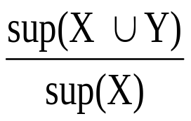
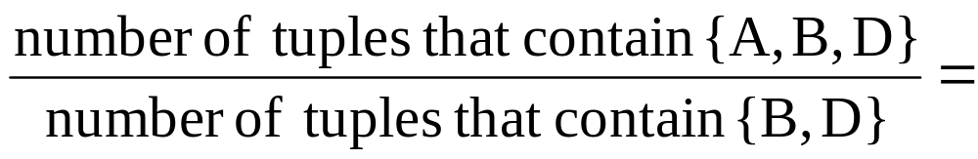
Example
TID date items_bought
100 10/10/99 {F,A,D,B}
200 15/10/99 {D,A,C,E,B}
300 19/10/99 {C,A,B,E}
400 20/10/99 {B,A,D}
Remember:
conf(X ⇒ Y) =
What is the support and confidence of the rule: {B,D} ⇒ {A}
Support:
  percentage of tuples that contain {A,B,D} =
75%
Confidence:
100%

Slide 10
Association Rule Mining Task
Given a set of transactions T, the goal of association rule mining is to find all rules having
  support ≥ minsup threshold
  confidence ≥ minconf threshold
Brute-force approach:
  List all possible association rules
  Compute the support and confidence for each rule
  Prune rules that fail the minsup and minconf thresholds
  ⇒ Computationally prohibitive!

Slide 11
Mining Association Rules
Example of Rules:
{Milk,Diaper} → {Beer} (s=0.4, c=0.67)
{Milk,Beer} → {Diaper} (s=0.4, c=1.0)
{Diaper,Beer} → {Milk} (s=0.4, c=0.67)
{Beer} → {Milk,Diaper} (s=0.4, c=0.67)
{Diaper} → {Milk,Beer} (s=0.4, c=0.5)
{Milk} → {Diaper,Beer} (s=0.4, c=0.5)
Observations:
All the above rules are binary partitions of the same itemset:
{Milk, Diaper, Beer}
Rules originating from the same itemset have identical support but
can have different confidence
Thus, we may decouple the support and confidence requirements

Slide 12
Mining Association Rules
Two-step approach:
  Frequent Itemset Generation
    Generate all itemsets whose support ≥ minsup
  Rule Generation
    Generate high confidence rules from each frequent itemset, where each rule is a binary partitioning of a frequent itemset
Frequent itemset generation is still computationally expensive

Slide 13

Frequent Itemset Generation
Given d items, there are 2^{d} possible candidate itemsets

Slide 14

Frequent Itemset Generation
Brute-force approach:
  Each itemset in the lattice is a candidate frequent itemset
  Count the support of each candidate by scanning the database
  Match each transaction against every candidate
  Complexity ~ O(NMw) => Expensive since M = 2^{d} !!!

Slide 15
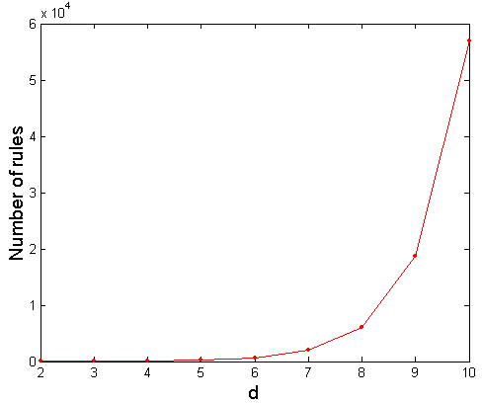

Computational Complexity
Given d unique items:
  Total number of itemsets = 2^{d}
  Total number of possible association rules:
If d=6, R = 602 rules

Slide 16
Frequent Itemset Generation Strategies
Reduce the number of candidates (M)
  Complete search: M=2^{d}
  Use pruning techniques to reduce M
Reduce the number of transactions (N)
  Reduce size of N as the size of itemset increases
  Used by DHP and vertical-based mining algorithms
Reduce the number of comparisons (NM)
  Use efficient data structures to store the candidates or transactions
  No need to match every candidate against every transaction

Slide 17
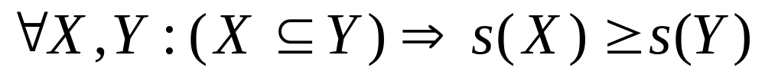
Reducing Number of Candidates
Apriori principle:
  If an itemset is frequent, then all of its subsets must also be frequent
Apriori principle holds due to the following property of the support measure:
  Support of an itemset never exceeds the support of its subsets
  This is known as the anti-monotone property of support

Slide 18
Example
s(Bread) > s(Bread, Beer)
s(Milk) > s(Bread, Milk)
s(Diaper, Beer) > s(Diaper, Beer, Coke)

Slide 19


Illustrating Apriori Principle
Found to be Infrequent
Pruned supersets

Slide 20
Mining Frequent Itemsets: the Key Step
Find the frequent itemsets: the sets of items that have minimum support
  A subset of a frequent itemset must also be a frequent itemset
    i.e., if {AB} is a frequent itemset, both {A} and {B} should be frequent itemsets
  Iteratively find frequent itemsets with cardinality from 1 to m (m-itemset): Use frequent k-itemsets to explore (k+1)-itemsets.
Use the frequent itemsets to generate association rules.

Slide 21

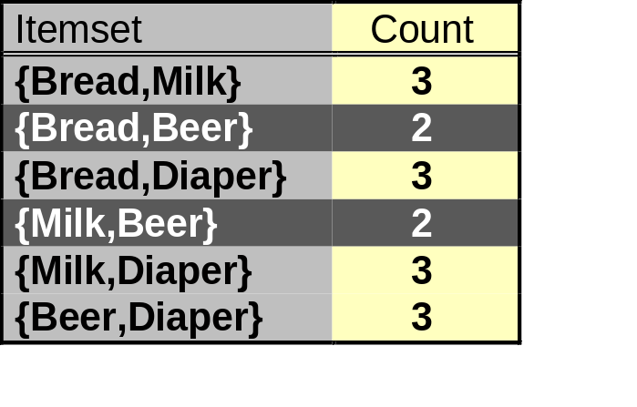
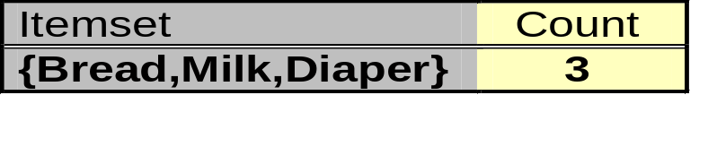
Illustrating Apriori Principle
Items (1-itemsets)
Pairs (2-itemsets)
(No need to generate
candidates involving Coke
or Eggs)
Minimum Support = 3
Triplets (3-itemsets)
If every subset is considered,
⁶C₁ + ⁶C₂ + ⁶C₃ = 41
With support-based pruning,
6 + 6 + 1 = 13

Slide 22
The Apriori Algorithm (the general idea)
Find frequent 1-items and put them to L_{k} (k=1)
Use L_{k} to generate a collection of candidate itemsets C_{k+1} with size (k+1)
Scan the database to find which itemsets in C_{k+1} are frequent and put them into L_{k+1}
If L_{k+1} is not empty
  k=k+1
  GOTO 2
R. Agrawal, R. Srikant: "Fast Algorithms for Mining Association Rules",
Proc. of the 20th Int'l Conference on Very Large Databases, Santiago, Chile, Sept. 1994.

Slide 23
The Apriori Algorithm
Pseudo-code:
    C_{k}: Candidate itemset of size k
    L_{k} : frequent itemset of size k
    L₁ = {frequent items};
    for (k = 1; L_{k} !=∅; k++) do begin
    C_{k+1} = candidates generated from L_{k};
    // join and prune steps
    for each transaction t in database do
      increment the count of all candidates in C_{k+1} that are contained in t
    L_{k+1} = candidates in C_{k+1} with min_support (frequent)
    end
    return ∪_{k} L_{k};
Important steps in candidate generation:
  Join Step: C_{k+1} is generated by joining L_{k} with itself
  Prune Step: Any k-itemset that is not frequent cannot be a subset of a frequent (k+1)-itemset

Slide 24








The Apriori Algorithm — Example
Database D
L₁
C₁
Scan D
min_sup=2=50%
C₂
C₂
L₂
Scan D
C₃
Scan D
L₃

Slide 25
How to Generate Candidates?
Suppose the items in L_{k} are listed in an order
Step 1: self-joining L_{k} (IN SQL)
  insert into C_{k+1}
  select p.item₁, p.item₂, …, p.item_{k}, q.item_{k}
  from L_{k} p, L_{k} q
  where p.item₁=q.item₁, …, p.item_{k-1}=q.item_{k-1}, p.item_{k} < q.item_{k}
Step 2: pruning
  forall itemsets c in C_{k+1} do
    forall k-subsets s of c do
      if (s is not in L_{k}) then delete c from C_{k+1}

Slide 26
Example of Candidates Generation
L₃={abc, abd, acd, ace, bcd}
Self-joining: L₃*L₃
  abcd from abc and abd
  acde from acd and ace
Pruning:
  acde is removed because ade is not in L₃
C₄={abcd}
{a,c,d}
{a,c,e}
X
{a,c,d,e}
acd
ace
ade
cde
√
√
X

Slide 27
How to Count Supports of Candidates?
Why counting supports of candidates a problem?
  The total number of candidates can be huge
  One transaction may contain many candidates
Method:
  Candidate itemsets are stored in a hash-tree
  Leaf node of hash-tree contains a list of itemsets and counts
  Interior node contains a hash table
  Subset function: finds all the candidates contained in a transaction

Slide 28
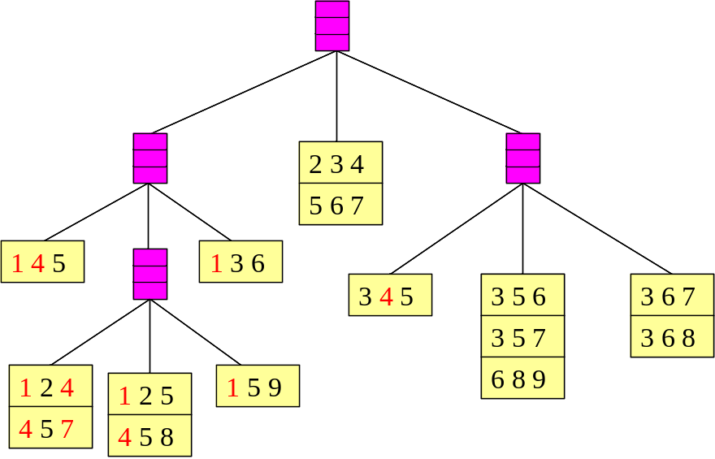
Apriori: Implementation Using Hash Tree
Suppose you have 15 candidate itemsets of length 3:
{1 4 5}, {1 2 4}, {4 5 7}, {1 2 5}, {4 5 8}, {1 5 9}, {1 3 6}, {2 3 4}, {5 6 7}, {3 4 5}, {3 5 6}, {3 5 7}, {6 8 9}, {3 6 7}, {3 6 8}
You need:
Hash function
Max leaf size: max number of itemsets stored in a leaf node
  (if number of candidate itemsets exceeds max leaf size, split the node)
Hash function
3,6,9
1,4,7
2,5,8

Slide 29
Example of the hash-tree for C₃
2345
look for 2XX
345
look for 3XX
Hash function: mod 3
12345
H
H
Hash on 1st item
12345
look for 1XX
1,4,..
2,5,..
3,6,..
H
234
567
H
Hash on 2nd item
12345
look for 12X
∅
145
H
345
356
689
367
368
12345
look for 13X (null)
124
457
125
458
159
12345
look for 14X

Slide 30
Methods to Improve Apriori’s Efficiency
√
Hash-based itemset counting: A k-itemset whose corresponding hashing bucket count is below the threshold cannot be frequent
Transaction reduction: A transaction that does not contain any frequent k-itemset is useless in subsequent scans
Partitioning: Any itemset that is potentially frequent in DB must be frequent in at least one of the partitions of DB
Sampling: mining on a subset of given data, lower support threshold + a method to determine the completeness
Dynamic itemset counting: add new candidate itemsets only when all of their subsets are estimated to be frequent
√

Slide 31
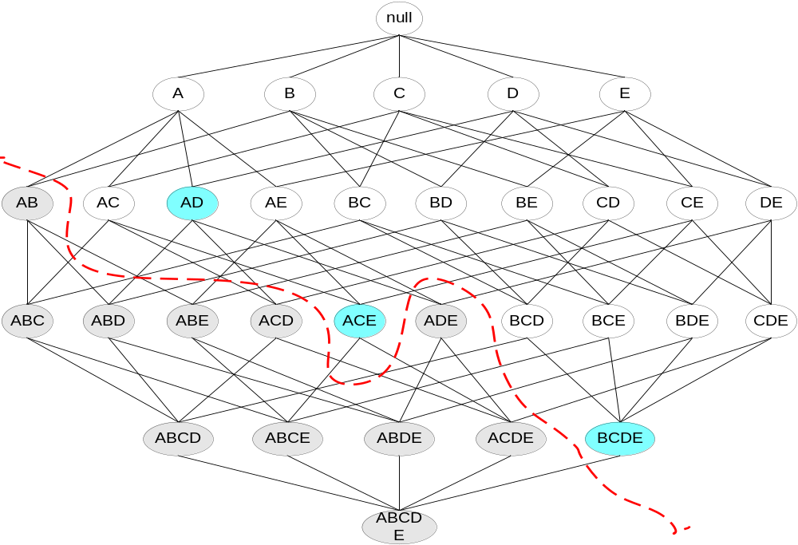
Maximal Frequent Itemset
An itemset is maximal frequent if none of its immediate supersets is frequent
Maximal Itemsets
Infrequent Itemsets
Border

Slide 32
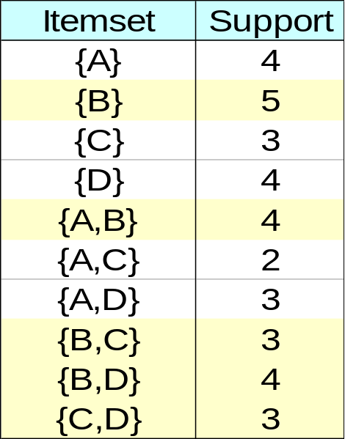
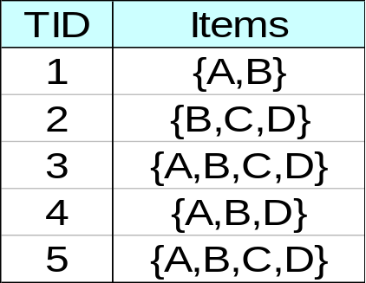
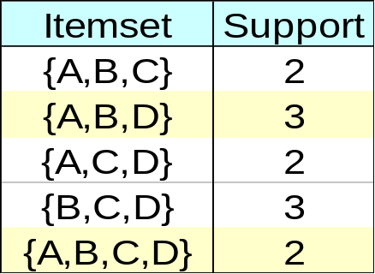
Closed Itemset
An itemset is closed if none of its immediate supersets has the same support as the itemset

Slide 33
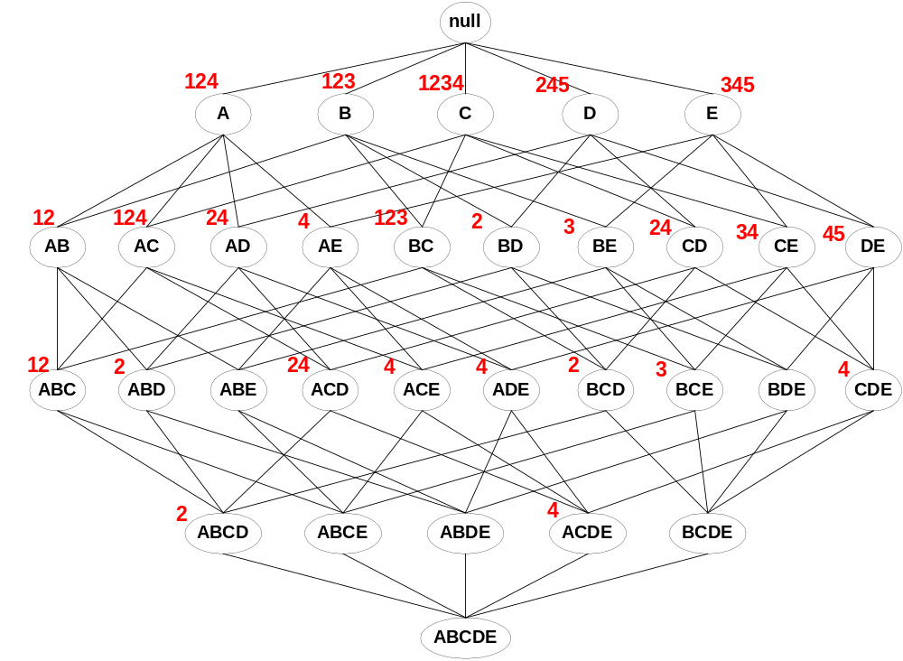
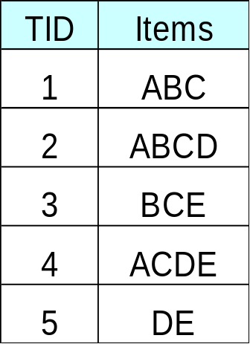
Maximal vs Closed Itemsets
Transaction Ids
Not supported by any transactions

Slide 34
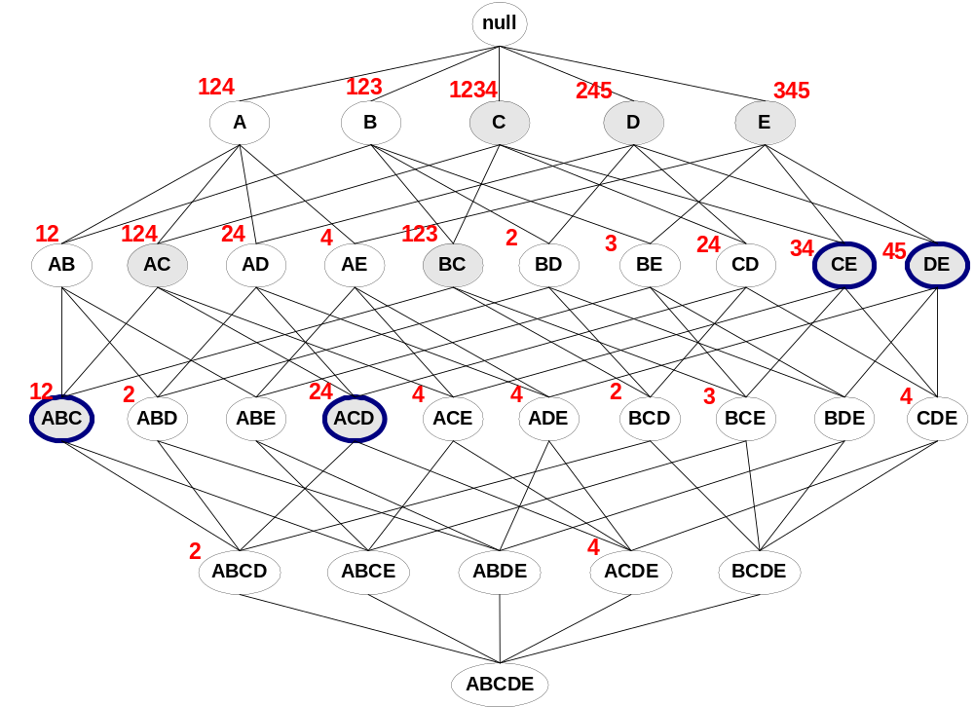
Maximal vs Closed Frequent Itemsets
Minimum support = 2
Closed but not maximal
Closed and maximal
# Closed = 9
# Maximal = 4

Slide 35
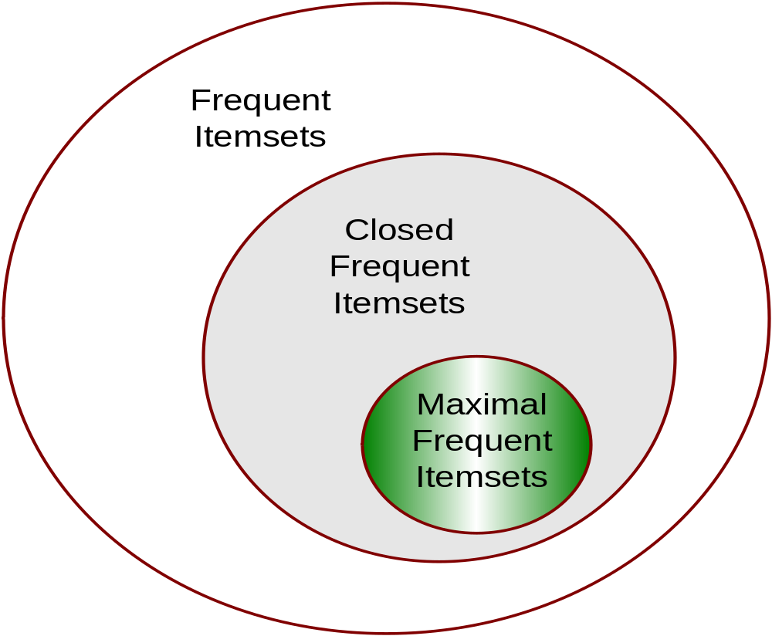
Maximal vs Closed Itemsets

Slide 36
Factors Affecting Complexity
Choice of minimum support threshold
  lowering support threshold results in more frequent itemsets
  this may increase number of candidates and max length of frequent itemsets
Dimensionality (number of items) of the data set
  more space is needed to store support count of each item
  if number of frequent items also increases, both computation and I/O costs may also increase
Size of database
  since Apriori makes multiple passes, run time of algorithm may increase with number of transactions
Average transaction width
  transaction width increases with denser data sets
  This may increase max length of frequent itemsets and traversals of hash tree (number of subsets in a transaction increases with its width)

Slide 37
Rule Generation
Given a frequent itemset L, find all non-empty subsets f ⊂ L such that f → L – f satisfies the minimum confidence requirement
  If {A,B,C,D} is a frequent itemset, candidate rules:
    ABC →D, ABD →C, ACD →B, BCD →A,
    A →BCD, B →ACD, C →ABD, D →ABC
    AB →CD, AC → BD, AD → BC, BC →AD,
    BD →AC, CD →AB,
If |L| = k, then there are 2^{k} – 2 candidate association rules (ignoring L → ∅ and ∅ → L)

Slide 38
Rule Generation
How to efficiently generate rules from frequent itemsets?
  In general, confidence does not have an anti-monotone property
    c(ABC →D) can be larger or smaller than c(AB →D)
  But confidence of rules generated from the same itemset has an anti-monotone property
  e.g., L = {A,B,C,D}:
  c(ABC → D) ≥ c(AB → CD) ≥ c(A → BCD)
    Confidence is anti-monotone w.r.t. number of items on the RHS of the rule

Slide 39
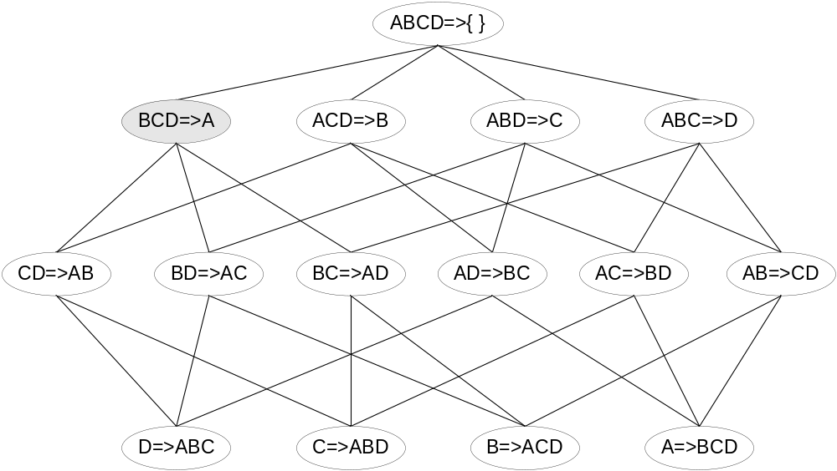

Rule Generation for Apriori Algorithm
Lattice of rules
Low Confidence Rule
Pruned Rules

Slide 40
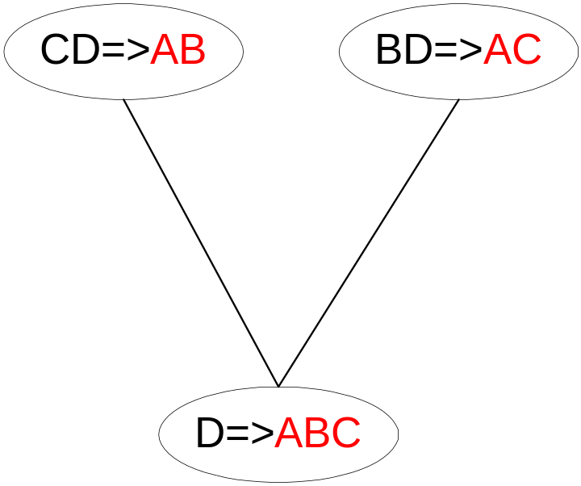
Rule Generation for Apriori Algorithm
Candidate rule is generated by merging two rules that share the same prefix
in the rule consequent
join(CD=>AB,BD=>AC)
would produce the candidate
rule D => ABC
Prune rule D=>ABC if its
subset AD=>BC does not have
high confidence

Slide 41
Is Apriori Fast Enough? — Performance Bottlenecks
The core of the Apriori algorithm:
  Use frequent (k – 1)-itemsets to generate candidate frequent k-itemsets
  Use database scan and pattern matching to collect counts for the candidate itemsets
The bottleneck of Apriori: candidate generation
  Huge candidate sets:
    10⁴ frequent 1-itemset will generate 10⁷ candidate 2-itemsets
    To discover a frequent pattern of size 100, e.g., {a₁, a₂, …, a₁₀₀}, one needs to generate 2¹⁰⁰ ≈ 10³⁰ candidates.
  Multiple scans of database:
    Needs (n +1 ) scans, n is the length of the longest pattern

Slide 42
FP-growth: Mining Frequent Patterns Without Candidate Generation
Compress a large database into a compact, Frequent-Pattern tree (FP-tree) structure
  highly condensed, but complete for frequent pattern mining
  avoid costly database scans
Develop an efficient, FP-tree-based frequent pattern mining method
  A divide-and-conquer methodology: decompose mining tasks into smaller ones
  Avoid candidate generation: sub-database test only!

Slide 43
FP-tree Construction from a Transactional DB
min_support = 3
TID Items bought (ordered) frequent items
100 {f, a, c, d, g, i, m, p} {f, c, a, m, p}
200 {a, b, c, f, l, m, o} {f, c, a, b, m}
300 {b, f, h, j, o} {f, b}
400 {b, c, k, s, p} {c, b, p}
500 {a, f, c, e, l, p, m, n} {f, c, a, m, p}
Item frequency
f 4
c 4
a 3
b 3
m 3
p 3
Steps:
Scan DB once, find frequent 1-itemsets (single item patterns)
Order frequent items in descending order of their frequency
Scan DB again, construct FP-tree

Slide 44
FP-tree Construction
min_support = 3
TID freq. Items bought
100 {f, c, a, m, p}
200 {f, c, a, b, m}
300 {f, b}
400 {c, p, b}
500 {f, c, a, m, p}
Item frequency
f 4
c 4
a 3
b 3
m 3
p 3
root
f:1
c:1
a:1
m:1
p:1

Slide 45
FP-tree Construction
min_support = 3
TID freq. Items bought
100 {f, c, a, m, p}
200 {f, c, a, b, m}
300 {f, b}
400 {c, p, b}
500 {f, c, a, m, p}
Item frequency
f 4
c 4
a 3
b 3
m 3
p 3
root
f:2
c:2
a:2
m:1
b:1
p:1
m:1

Slide 46
FP-tree Construction
min_support = 3
TID freq. Items bought
100 {f, c, a, m, p}
200 {f, c, a, b, m}
300 {f, b}
400 {c, p, b}
500 {f, c, a, m, p}
Item frequency
f 4
c 4
a 3
b 3
m 3
p 3
root
f:3
c:1
c:2
b:1
b:1
a:2
p:1
m:1
b:1
p:1
m:1

Slide 47
FP-tree Construction
TID freq. Items bought
100 {f, c, a, m, p}
200 {f, c, a, b, m}
300 {f, b}
400 {c, p, b}
500 {f, c, a, m, p}
min_support = 3
Item frequency
f 4
c 4
a 3
b 3
m 3
p 3
root
Header Table
Item frequency head
f 4
c 4
a 3
b 3
m 3
p 3
f:4
c:1
c:3
b:1
b:1
a:3
p:1
m:2
b:1
p:2
m:1

Slide 48
Benefits of the FP-tree Structure
Completeness:
  never breaks a long pattern of any transaction
  preserves complete information for frequent pattern mining
Compactness
  reduce irrelevant information—infrequent items are gone
  frequency descending ordering: more frequent items are more likely to be shared
  never be larger than the original database (if not count node-links and counts)
  Example: For Connect-4 DB, compression ratio could be over 100

Slide 49
Mining Frequent Patterns Using FP-tree
General idea (divide-and-conquer)
  Recursively grow frequent pattern path using the FP-tree
Method
  For each item, construct its conditional pattern-base, and then its conditional FP-tree
  Repeat the process on each newly created conditional FP-tree
  Until the resulting FP-tree is empty, or it contains only one path (single path will generate all the combinations of its sub-paths, each of which is a frequent pattern)

Slide 50
Mining Frequent Patterns Using the FP-tree (cont’d)
Start with last item in order (i.e., p).
Follow node pointers and traverse only the paths containing p.
Accumulate all of transformed prefix paths of that item to form a conditional pattern base
f:4
c:1
Conditional pattern base for p
fcam:2, cb:1
c:3
b:1
a:3
p:1
Construct a new FP-tree based on this pattern, by merging all paths and keeping nodes that appear ≥sup times. This leads to only one branch c:3
Thus we derive only one frequent pattern cont. p. Pattern cp
p
m:2
p:2

Slide 51
Mining Frequent Patterns Using the FP-tree (cont’d)
Move to next least frequent item in order, i.e., m
Follow node pointers and traverse only the paths containing m.
Accumulate all of transformed prefix paths of that item to form a conditional pattern base
m-conditional pattern base:
  fca:2, fcab:1
f:4
c:3
{}
All frequent patterns that include m
m,
fm, cm, am,
fcm, fam, cam,
fcam
a:3


m
f:3
m:2
b:1
c:3
m:1
a:3
m-conditional FP-tree (contains only path fca:3)

Slide 52
Properties of FP-tree for Conditional Pattern Base Construction
Node-link property
  For any frequent item a_{i}, all the possible frequent patterns that contain a_{i} can be obtained by following a_{i}'s node-links, starting from a_{i}'s head in the FP-tree header
Prefix path property
  To calculate the frequent patterns for a node a_{i} in a path P, only the prefix sub-path of a_{i} in P need to be accumulated, and its frequency count should carry the same count as node a_{i}.

Slide 53
Conditional Pattern-Bases for the example
Item
Conditional pattern-base
Conditional FP-tree
p
{(fcam:2), (cb:1)}
{(c:3)}|p
m
{(fca:2), (fcab:1)}
{(f:3, c:3, a:3)}|m
b
{(fca:1), (f:1), (c:1)}
Empty
a
{(fc:3)}
{(f:3, c:3)}|a
c
{(f:3)}
{(f:3)}|c
f
Empty
Empty

Slide 54
Why Is Frequent Pattern Growth Fast?
Performance studies show
  FP-growth is an order of magnitude faster than Apriori, and is also faster than tree-projection
Reasoning
  No candidate generation, no candidate test
  Uses compact data structure
  Eliminates repeated database scan
  Basic operation is counting and FP-tree building

Slide 55

FP-growth vs. Apriori: Scalability With the Support Threshold
Data set T25I20D10K

